Slide 1
Rattle
What is Rattle?

Slide 2
Rattle
Rattle is free and open source GUI tool for data mining.
Rattle is used without writing a single code in data mining projects.
Rattle is built on the statistical language R
Rattle is simple to use and quick to deploy.
Rattle allow data processing, modeling, and evaluation phases of a data mining project.

Slide 3
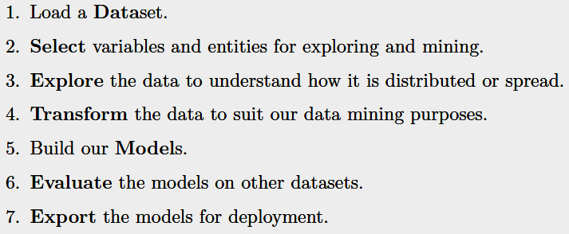
Rattle
Workflow of Rattle

Slide 4
Rattle Installation
To Install Rattle
Open R Console and write
install.packages(‘rattle’)
To start Rattle
library(rattle)
rattle()

Slide 5
Book on Rattle
Book on Rattle
“Data Mining with Rattle and R”
By Graham Williams
Download it from Library Genesis
http://gen.lib.rus.ec
psrana.com → Resource →
UNIT VII: Gold Mine for Researchers

Slide 6
Rattle
Learn more about Rattle
1. Go to psrana.com → Resource →
UNIT III: Learn R → 6. Rattle Videos
2. Go to Google and search for
"Data Mining using rattle".

Slide 7
Data Set
Where to get the datasets ?

Slide 8
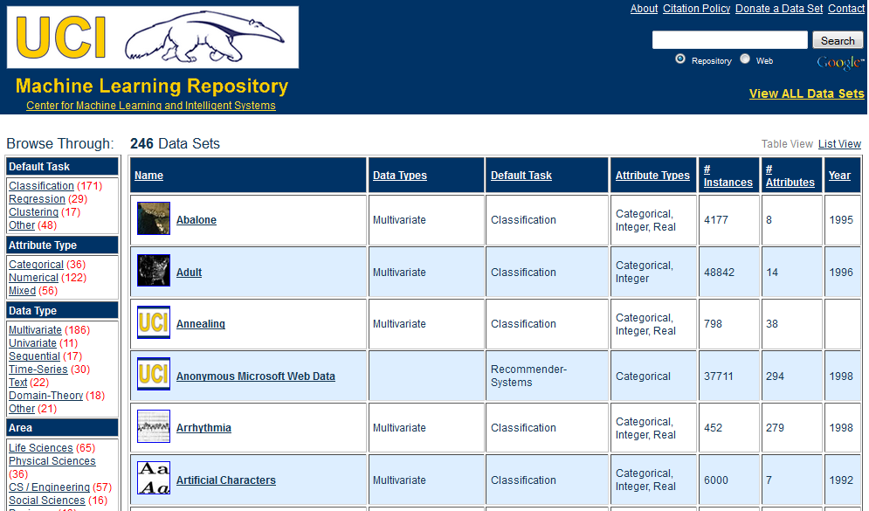
Data Set : UCI Library
Google→ “uci dataset”

Slide 9
Flow of data mining

Slide 10
Step1: Data Collection
Justify your data.
Purpose of your data.
Primary data or secondary data.
Type of data – single variant or multi variants.
Mention features of you dataset.
……… many more

Slide 11
Step2: Data Cleansing
Remove redundancy.
Removing missing values.
Normalize/transform your data.
……… many more

Slide 12
Step3: Feature Selection
It is a subset problem.
Select then minimum set features that gives best performance.
Compare the different features methods on prediction model performance.
……… many more

Slide 13
Step4: Division of data into Training & Testing
Divide the data into training & testing.
General rule 70-30.
  Train the model on 70% data
  Test the model on 30% data.
Try more combinations, like 50-50, 60-40, etc.
……… many more

Slide 14
Step5: Train the Model
Train the model on 70% data

Slide 15
Step6: Test the model
Test the model on 30% data

Slide 16
Step7: Cross Validation
Cross Validation is used to check the robustness of the model.
K-fold Validation is used.
Repeat Step 4 and Step 5 , 10 times
( 10-fold validation), observe the performance and plot the graph.

Slide 17
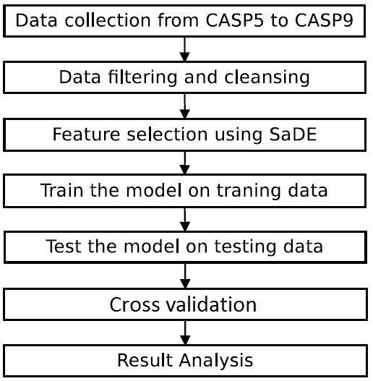
Flow of data mining

Slide 18
Some
Useful Resources

Slide 19
Useful Resource
Books
Applied Predictive Modeling
by Max Kuhn & Kjell Johnson
Data mining with Rattle and R
by Graham Williams

Slide 20
Useful Resource
Software - I
http://www.r-project.org
This is the main R web site with links to announcements, manuals, books, conference, and other information.
http://cran.r-project.org
CRAN, or the Comprehensive R Archive Network, is the primary repository for R and numerous add-on packages.
http://cran.r-project.org/web/views/MachineLearning.html
The machine learning Task View is a list of many predictive modeling packages in R.
http://caret.r-forge.r-project.org
The caret package is hosted here.

Slide 21
Useful Resource
Software – II
http://www.rulequest.com
RuleQuest releases commercial and open-source versions of Cubist and C5.0.
http://rattle.togaware.com
Rattle (Williams 2011) is a graphical user interface for R predictive models.
http://www.cs.waikato.ac.nz/ml/weka/
Weka is collection of Java programs for data mining.
http://orange.biolab.si
Orange is an open-source, cross-platform graphical user interface to many machine learning tools. The interface is a “pipeline” where users piece together components to create a workflow.

Slide 22
Useful Resource
Software – III
http://www.knime.org
“KNIME (Konstanz Information Miner) is a user-friendly and comprehensive open-source data integration, processing, analysis, and exploration platform.”
http://www.spss.com/software/modeler
The IBM SPSS Modeler, formerly called Clemintine, is a visual platform for model building.
http://www.sas.com/technologies/analytics/datamining/miner
A SAS product for data mining.
Other programs are listed at http://www.kdnuggets.com/software/suites

Slide 23
Useful Resource
Online Courses
www.cousera.org
Machine Learning
By Andrew Ng, Stanford University
www.YouTube.com
Search for “Datamining using rattle”

Slide 24
Useful Resource
Competitions on datamining
http://www.kaggle.com
http://tunedit.org
KDD Cup (Knowledge Discovery in Data)
http://www.kdnuggets.com

Slide 25
Useful Resource
Data Sets
http://archive.ics.uci.edu/ml
The University of California (Irvine) is a well-known location for classification and regression data sets.
http://www.kdnuggets.com/datasets
ACM has a special interest group on KDD. The KDD group organizes annual machine learning competitions.
http://fueleconomy.gov
Site of U.S. Department of Energy that lists different estimates of fuel economy for passenger cars and trucks.
http://www.cheminformatics.org
Contains many examples of computational chemistry data sets.
http://www.ncbi.nlm.nih.gov/geo
Free dataset of microarray, next-generation sequencing, and other forms of highthroughput functional genomic.

Slide 26
Useful Resource
Blogs
  R-bloggers | R news & tutorials from the web
www.r-bloggers.com
  Revolutions: R
blog.revolutionanalytics.com/r

Slide 27
Research Topics in Datamining

Slide 28
Research Topics in Datamining
Topic 1
Feature Selection / Feature minimization /
Dimension Reduction / Feature Extraction
Choosing the smaller set of features that gives better performance of datamining model. Suppose there 1000 features and you have to select minimum set of features ( let say 35).
Find or Develop new/hybrid feature selection method.

Slide 29
Research Topics in Datamining
Topic 2
Performance comparison of different machine learning models on the dataset.
Performance parameters:
  R²
  Correlation
  Accuracy
  Prediction Time
  RMSE (Root Mean Square Error)

Slide 30
Research Topics in Datamining
Topic 3
Validation of your of best selected model.
To check the biasness of model towards data.
Cross validation of best selected model.
K-fold cross validation method;
e.g. 10-fold cross validation.

Slide 31
Paper Writing
By adopting the above said method you can easily write a conference paper.
… But what about Journal…..??

Slide 32
Paper Writing for journal
Your data must be primary i.e own generated data.
New / Hybrid feature selection method must be used.
Compare the performance with 4-5 methods.
Cross validate the performance.

Slide 33
Research Topic in Machine Learning
www.scikit-learn.org
Contain more then100 example with dataset related to real world problems:
Image Processing
Text Classification
Intrusion Detection
Financial / Marketing ….. etc

